Slide 1

30% Presentation
AI-Assisted Learning Management System
Hanzla Nouman CIIT/FA21-BSE-015/ATD
Laiba Binta Tahir CIIT/FA21-BSE-019/ATD
Arfah Ali CIIT/FA21-BSE-080/ATD
Supervisor
Mr. Mukhtiar Zamin
Department of Computer Science
COMSATS University Islamabad, Abbottabad Campus

Slide 2
Agenda of the Presentation
Brief Introduction
Scope
Functional & Non-Functional Requirements
User Goals
Use Case Diagram
Class Diagram
Sequence Diagram
System sequence diagram
Activity Diagram
Deployment Diagram
Pseudocode
Schedule
Conclusion

Slide 3
Brief Introduction
AI-Assisted LMS Overview:
Automates content creation, grading, recommendations, and analytics.
Provides a personalized, adaptive learning experience for students.

Slide 4
Scope
What are we Doing?
Included Features
What are we not Doing?
Content Generation
Content Recommendations
AI-Driven Evaluation
Data Analytics
Excluded Features
Diaries
Real-Time Communication
Parent Engagement
Automated attendance

Slide 5
Functional Requirements
Feature 1: Content Generation
CG-01: Teachers can auto-generate lectures by inputting objectives, topics, and references.
CG-02: Teachers can edit and refine AI-generated content.
CG-03: Flexible options to save lectures as drafts or publish them for student access.
Feature 2: Automated Evaluations
FR-AE-001: Real-time feedback after quiz submissions to highlight improvement areas.
FR-AE-002: AI-powered self-assessment for written and multiple-choice responses.

Slide 6
Functional Requirements
Feature 3: Performance Analytics
FR-PA-001: Analytics Dashboard Visualized trends on student performance, attendance, and engagement.
FR-PA-002: AI predicts future performance using learning patterns and attendance data.
Feature 4: Personalized Learning
FR-PL-001: Tailored learning material based on students' history, preferences, and performance metrics.
FR-PL-002: Teachers can create interactive content (quizzes, assignments) customized to student needs.

Slide 7
Non-Functional Requirements
Performance
Reliability
Usability
Scalability
Maintainability
Security

Slide 8
User Goals
Student
Enhance learning experiences with personalized, interactive, and evaluative tools.
Teacher
Simplify content creation, improve instruction with insights, and automate assessments.
Admin
Maintain system integrity, monitor user performance, and manage operational workflows.

Slide 9
Use Cases
Login
Add users
Edit user
Delete user
Create class
Edit class
Delete class
Create course
Edit course
Delete course
Add new students

Slide 10
Use Cases continued..
View class performance
View student performance
Create lecture
Publish lecture
Access recommended resources
Save recommended resources
Create notes
Edit notes
Delete notes

Slide 11
Use Cases continued..
View grades
View reports
Create assignment
Delete assignment
Attempt assignment
Evaluate assignment
Create quiz
Delete quiz
Attempt quiz
Evaluate quiz
Check performance
Use chatbot
Logout

Slide 12
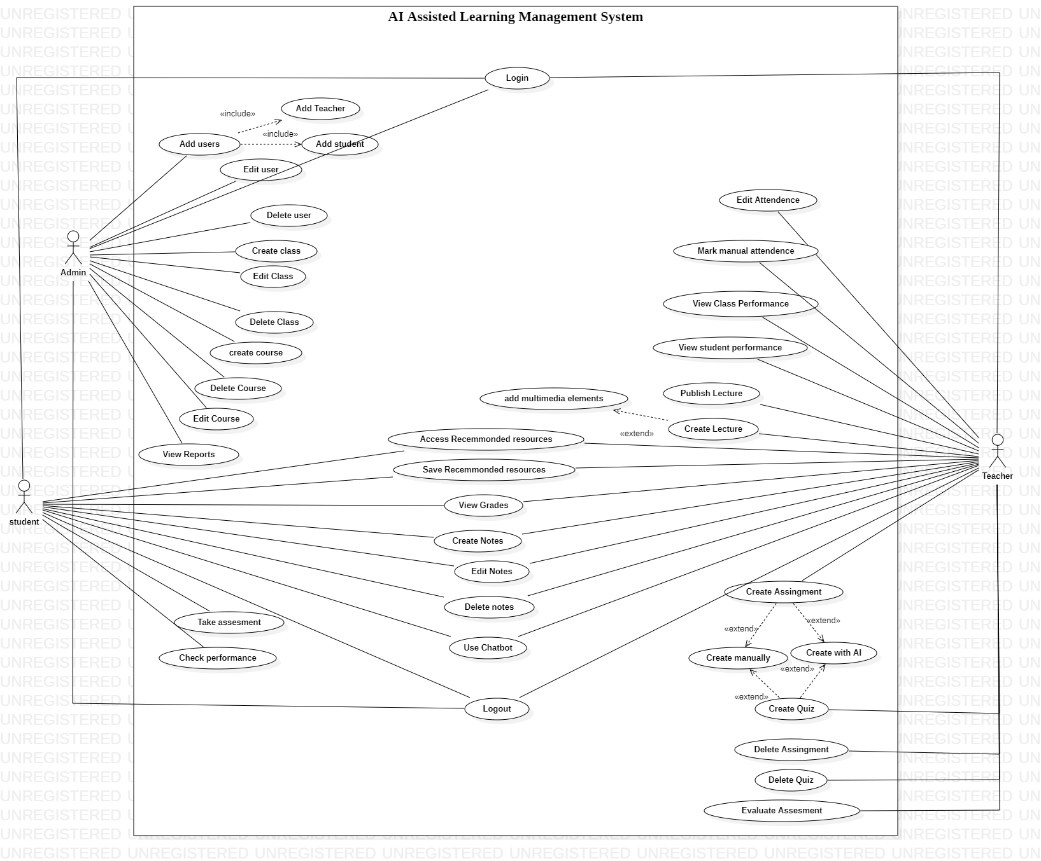
Use Case Diagram
Figure: Use case Diagram(Tool: StarUML)

Slide 13
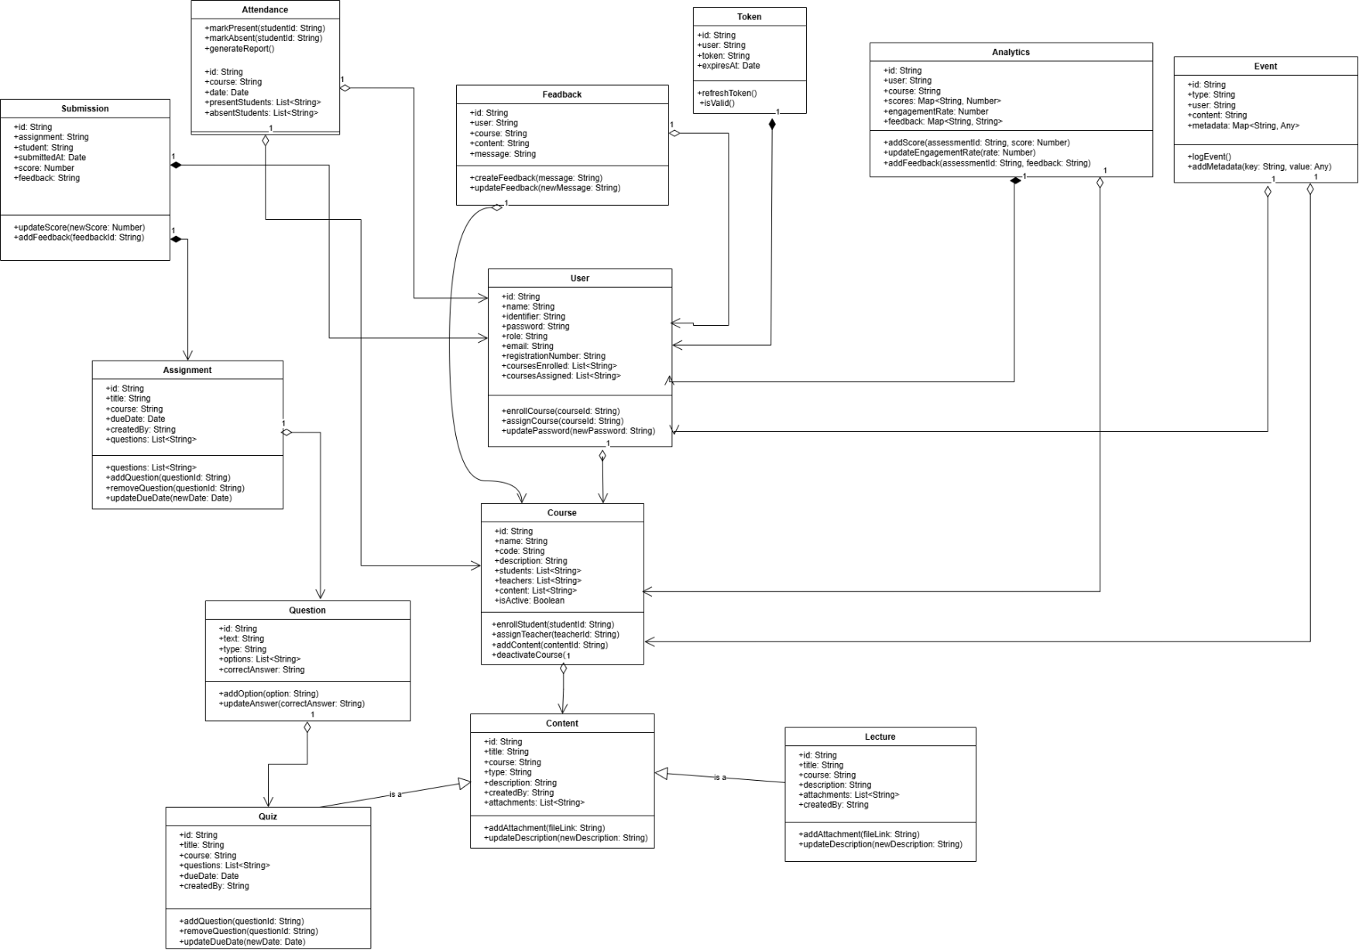
Class Diagram
Figure: Class Diagram

Slide 14
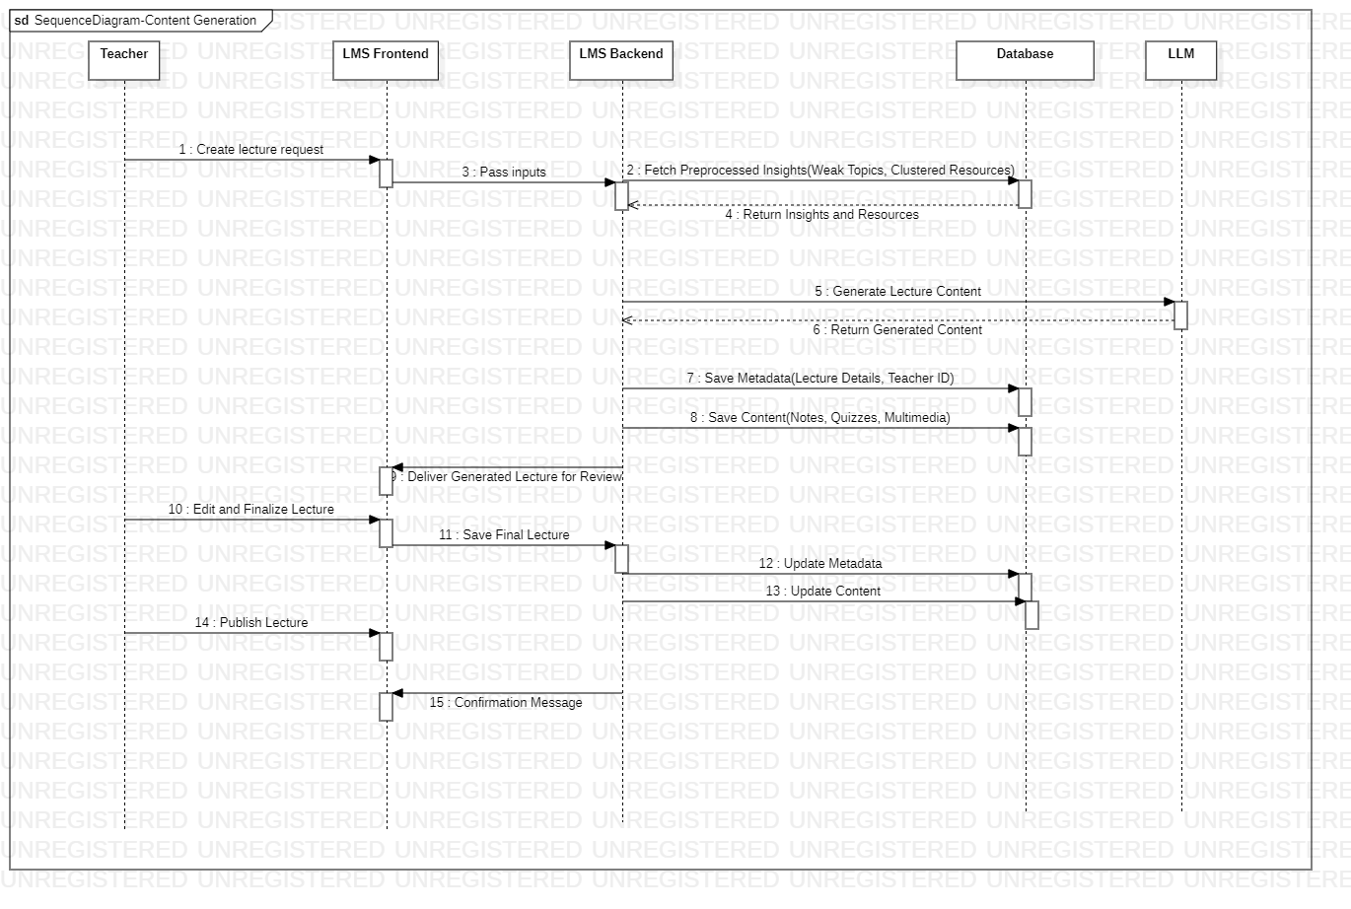
Sequence Diagram
Figure: Sequence Diagram : Content creation

Slide 15
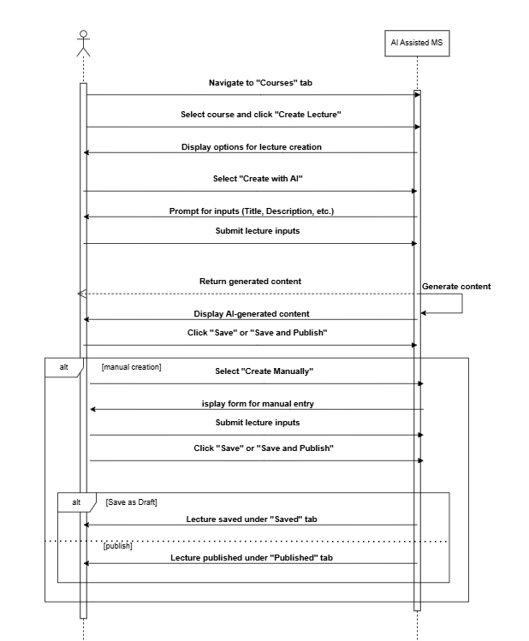
System Sequence Diagram
Figure: Create lecture (Tool: Draw.io)

Slide 16
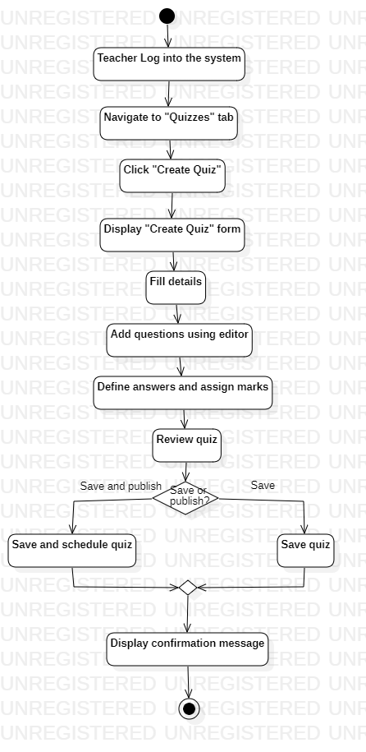
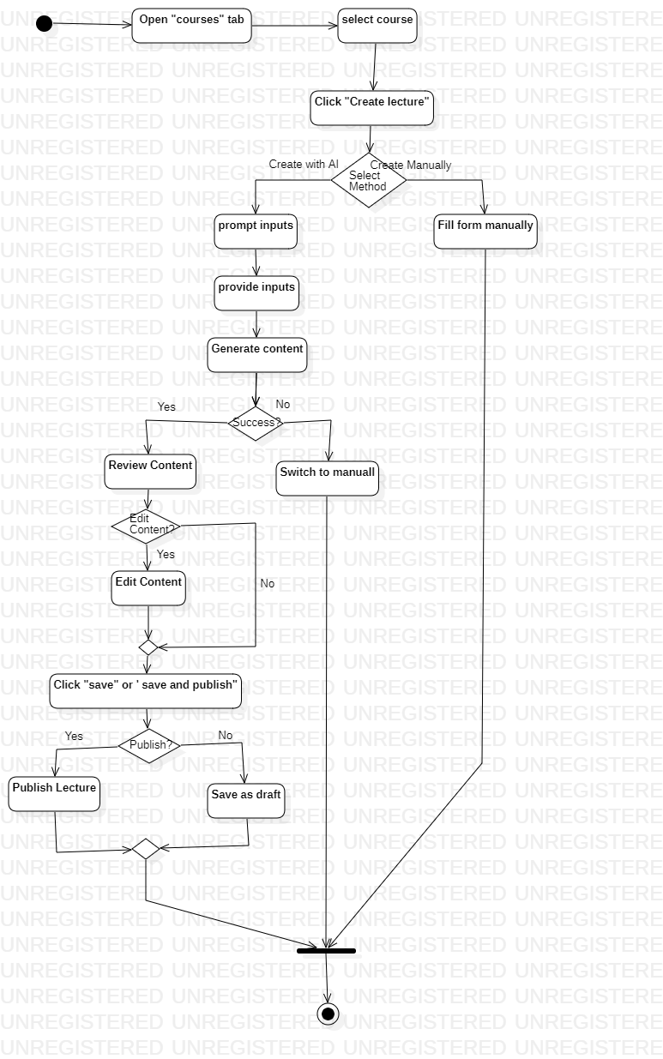
Activity Diagram
Figure: Create lecture
Figure: Create Quiz

Slide 17
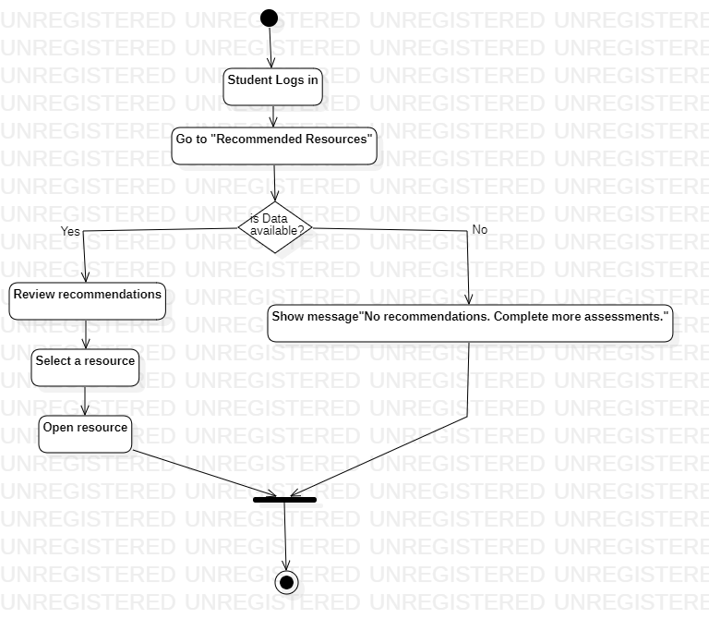
Activity Diagram
Figure: Access recommended resources

Slide 18
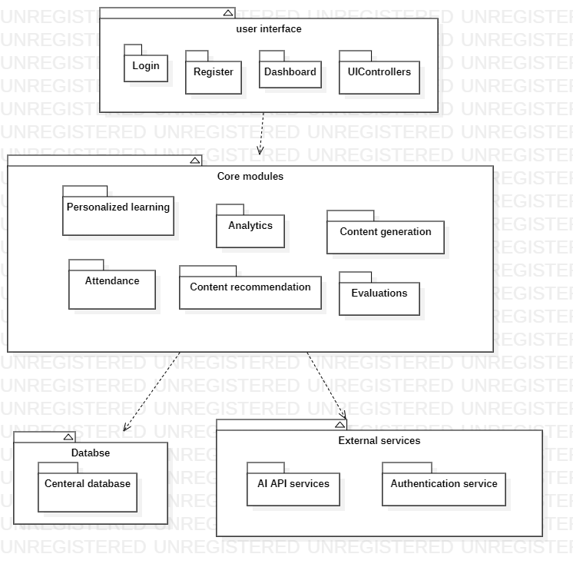
Package Diagram
Figure: Package diagram (tool: starUML)

Slide 19
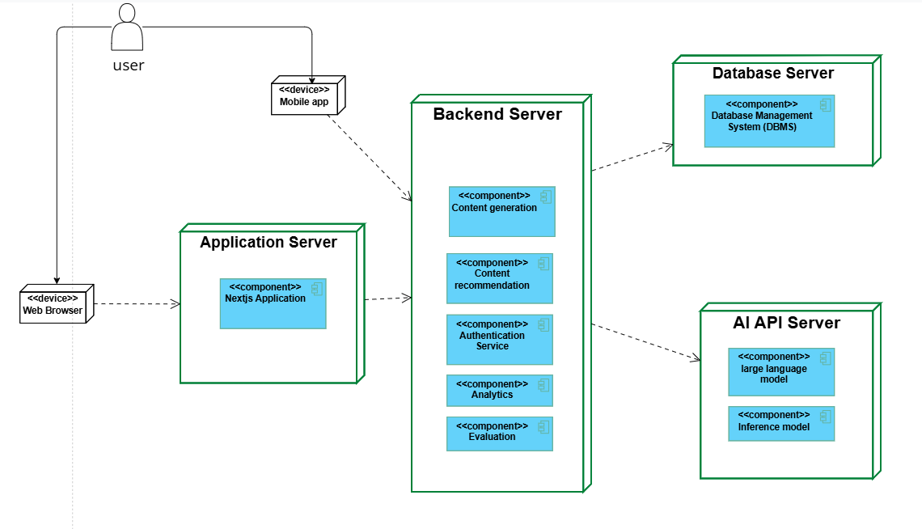
Deployment Diagram
Figure: Deployment diagram (tool: visual paradigm)

Slide 20
Decision Table
CONDITIONS | Rule 1 | Rule 2 | Rule 3 | Rule 4 | Rule 5 | Rule 6 | Rule 7 | Rule 8
Teacher logged in | T | T | T | T | F | F | F | F
Course access available | T | T | T | F | T | F | T | F
AI system functional | T | F | T | T | T | T | F | F
Content passes validation | T | T | F | F | T | F | T | F
ACTIONS | Rule 1 | Rule 2 | Rule 3 | Rule 4 | Rule 5 | Rule 6 | Rule 7 | Rule 8
Generate content with AI | Yes | No | Yes | No | No | No | No | No
Prompt teacher to retry AI | No | Yes | No | No | No | No | Yes | Yes
Switch to manual creation | No | Yes | Yes | Yes | No | No | Yes | Yes
Save as draft | Yes | No | No | No | No | No | No | No
Save and publish successfully | Yes | No | No | No | No | No | No | No
Display error message | No | Yes | Yes | Yes | Yes | Yes | Yes | Yes
Table: Create lecture

Slide 21
Pseudocode
Step 4: Teacher Review
reviewed_content ← teacher_review(notes, quizzes, multimedia)
IF reviewed_content["status"] == "Draft":
save_to_db("Draft", topic, objectives, reviewed_content)
ELSE IF reviewed_content["status"] == "Published":
save_to_db("Published", topic, objectives, reviewed_content)
Step 5: Notify Success
RETURN "Lecture created successfully!"
END FUNCTION
FUNCTION create_lecture(inputs):
Step 1: Input Collection
topic ← inputs["topic"]
objectives ← inputs["objectives"]
formats ← inputs["formats"]
references ← inputs.get("references", [])
Step 2: Fetch Insights
insights ← fetch_insights(topic)
weak_topics ← insights["weak_topics"]
resources ← insights["clustered_resources"]
Step 3: Generate Content
content ← generate_content(topic, objectives, weak_topics, resources)
notes ← content["notes"]
quizzes ← content["quizzes"]
multimedia ← content["multimedia"]

Slide 22
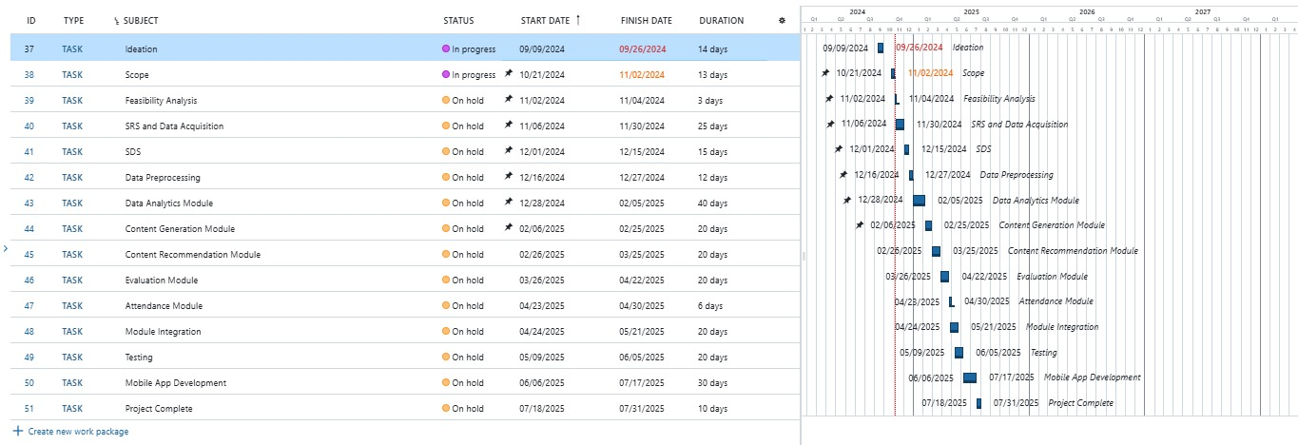
Schedule
Figure: Gantt chart

Slide 23
Details of 1st Iteration (30%)
Software Requirements Specification Document
Software Design Description Document
Basic Content Generation And LMS Activities

Slide 24
Details of 2nd Iteration (60%)
Data Synthesizing for ML Model
Initial Model Training for all Modules
Evaluation and Recommendation Module Functional
Data Pipeline for Continuous Data Stream

Slide 25
ML Models
Content Effectiveness
(GBR, Decision trees)
Personalized Recommendation
(NCF)
Behavioral Analysis
(Logistic Regression)
Content Clustering
(K means)
Knowledge Gap Analysis
(Random Forest Classifier)
Performance Forecasting
(LSTM)

Slide 26
Conclusion
AI-Assisted LMS aims to improve educational outcomes by reducing teacher workload, offering personalized learning, and utilizing data-driven insights.

